Slide 1
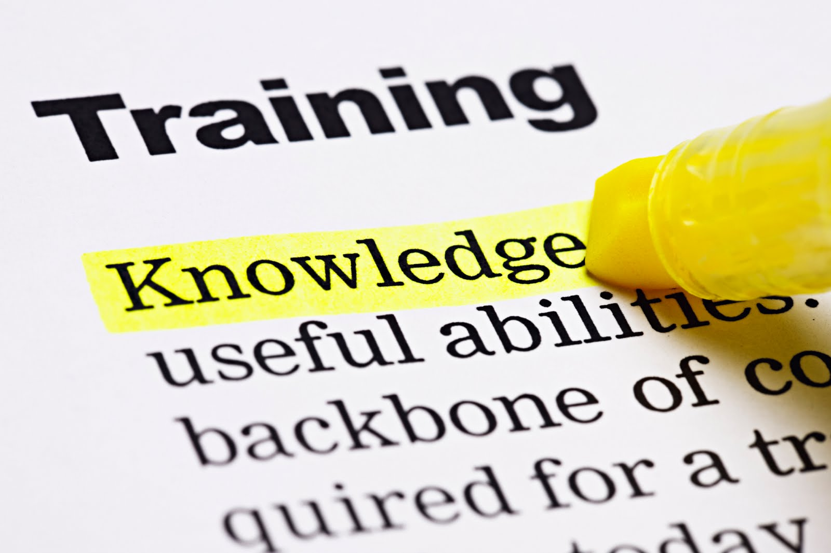
Professional Development Plan (PDP)

Slide 2
Professional Development
DEFINITION:
Professional Development provides the opportunity for leaders and employees to identify training and development needs in order to ensure job and organizational success.

Slide 3
Professional Development
What’s in it for you!
Provides opportunity to develop a plan of action for individual and organizational success
Provides all participants with opportunity to work out plans for achieving goals that relate to employee and organizational needs
Provides a tool for managers and employees to communicate and reach agreement on goals and developmental needs
Provides a means to acquire current and future "skill mix" information for the organization, as well as an opportunity for employees to obtain a better understanding of organizational career opportunities
Provide employees with another perspective on how their skills,
abilities, strengths, and developmental needs are viewed

Slide 4
Professional Development
Responsibility of - Manager
Develop plan that includes developmental objectives with the active participation of the employee
Ensure that employees possess the competencies (knowledge, skills, abilities) to achieve the team’s goals
Provide open feedback on performance and development
Communicate information about available tools and resources
Communicate business direction and skill needs
Facilitate, coach and support employees

Slide 5
Professional Development
Responsibility of - Employee
Develop an plan that includes developmental objectives
Communicate the plan with leadership
Do self-assessment and reflect on possibilities
Research occupational and employment options
Assess business partners needs, industry trends and plan ways to meet them

Slide 6
Employee
Lead the Process
Coach/Manager
Support the Process
Identify and share the contributions you want to make:
How can you best add value?
What areas are most consistent with your skills and interests?
How can you apply your skills to the team and the organization's needs?
Help the individual to explore the pros and cons of his or her choices
Ask for feedback and information concerning you and the team:
How are you viewed?
What is the team’s strategic direction?
How do things work around here?
Where and how do you get information?
Share your perception concerning the organization and the individual:
How this individual is viewed by others and myself.
The team’s strategic direction.
How things work around here.
Where and how to get information.
Develop a plan to get there:
Focus on development.
Begin with performance on present job.
Ask for feedback on your ideas.
Help the employee assess the plan:
Focus on development more than position.
Provide feedback, be responsible for promoting individual and organizational growth and Professional Development.
Establish a clear understanding of developmental goals and expectations; then review actual development at least twice/year with quarterly meetings recommended.
Provide feedback and information.
Follow-through on commitments
Follow-through on commitments

Slide 7
Professional Development
Process guidelines
Identify performance priorities
Determine skills needs assessment/development objectives
Explore development options and select activities
Discuss options, align with business objectives
Agree on success and measurement standards
Make the plan, implement, monitor and revise

Slide 8
Professional Development
Identifying performance priorities
Determine the tasks and projects that must be completed in order for the team to achieve its goals and operating requirements
Establish job goals aligned with business objectives
Define success, agree on what success will look like at the end of the process
Define how success will be measured and evaluated. It is important to connect individual development to how the skills add to the contributions made to help the team achieve its goals
Make sure the goals are SMART
(Specific, Measurable, Action-orientated, Realistic, and Timely)

Slide 9
Professional Development
The following are types of development options:
On-the-job training
Self-study courses
Shadowing
Discussion with subject matter experts
Rotational assignments
Developmental assignments
Participation on task force committee or team

Slide 10
Development Option Matrix
Professional and technical skills
Leadership
General management
Activities
Coaching
Feedback
Mentoring
Formal
Coursework
On the Job
Readings
Self-study
Professional organizations
Development in-place
Temporary
New positions
Self-
Development
Special
Assignment

Slide 11
Professional Development
Next steps
Plan the discussion
Manager
Employee
Focus on growth & Organizational success
Plan & commit to time to review and discuss – professional development is personal at its core
Create engagement, build for committment

